Slide 1
CSC207
Final Project
Group 86

Slide 2
Table of Contents
User Interface
UML & Difficulties
Future Implementation
Design Pattern
User Interface
Accessibility

Slide 3
UML
&
Difficulties

Slide 4
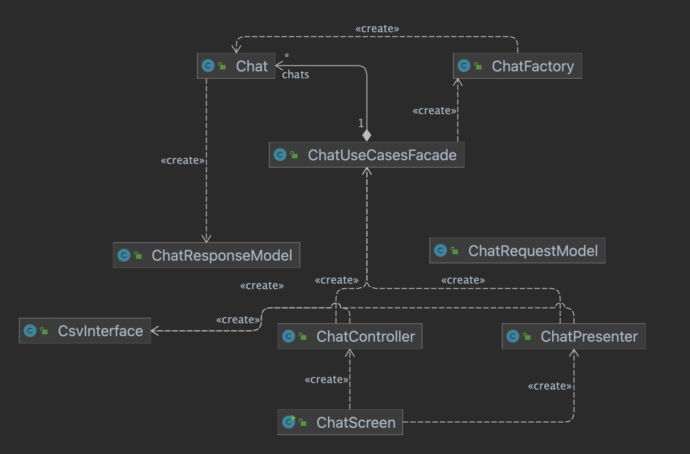
Chat Use cases
Notes:
I implemented the feature of chat, including sending a message to another user, and displaying all messages sent between two users.
My design adheres to Clean Architecture. The program is divided into 4 layers: Frameworks & Drivers, Interface Adapters, Application Business Rules, Enterprise Business Rule. When user send a message, the message is passed to ChatController from the ChatScreen, the controller then calls the Chat UseCase through Chat Request Model and passes the input to Chat Use Case. The Chat use case then calls the csv interface to access the database through response model.. The use case then passes the result to the chat presenter and csv interface through response model, and the presenter returns the result to the ChatScreen and csv interface write the result into database.
Difficulty
The thing I found most difficult was understanding the concept of Clean Architecture, SOLID design principles and design patterns and trying to implement them to fit our program. To solve this, I carefully read through all the code examples given by the professor and took detailed notes. Then I went to office hours for parts that I didn’t understand. After I was confident about everything, the coding part was pretty smooth.

Slide 5
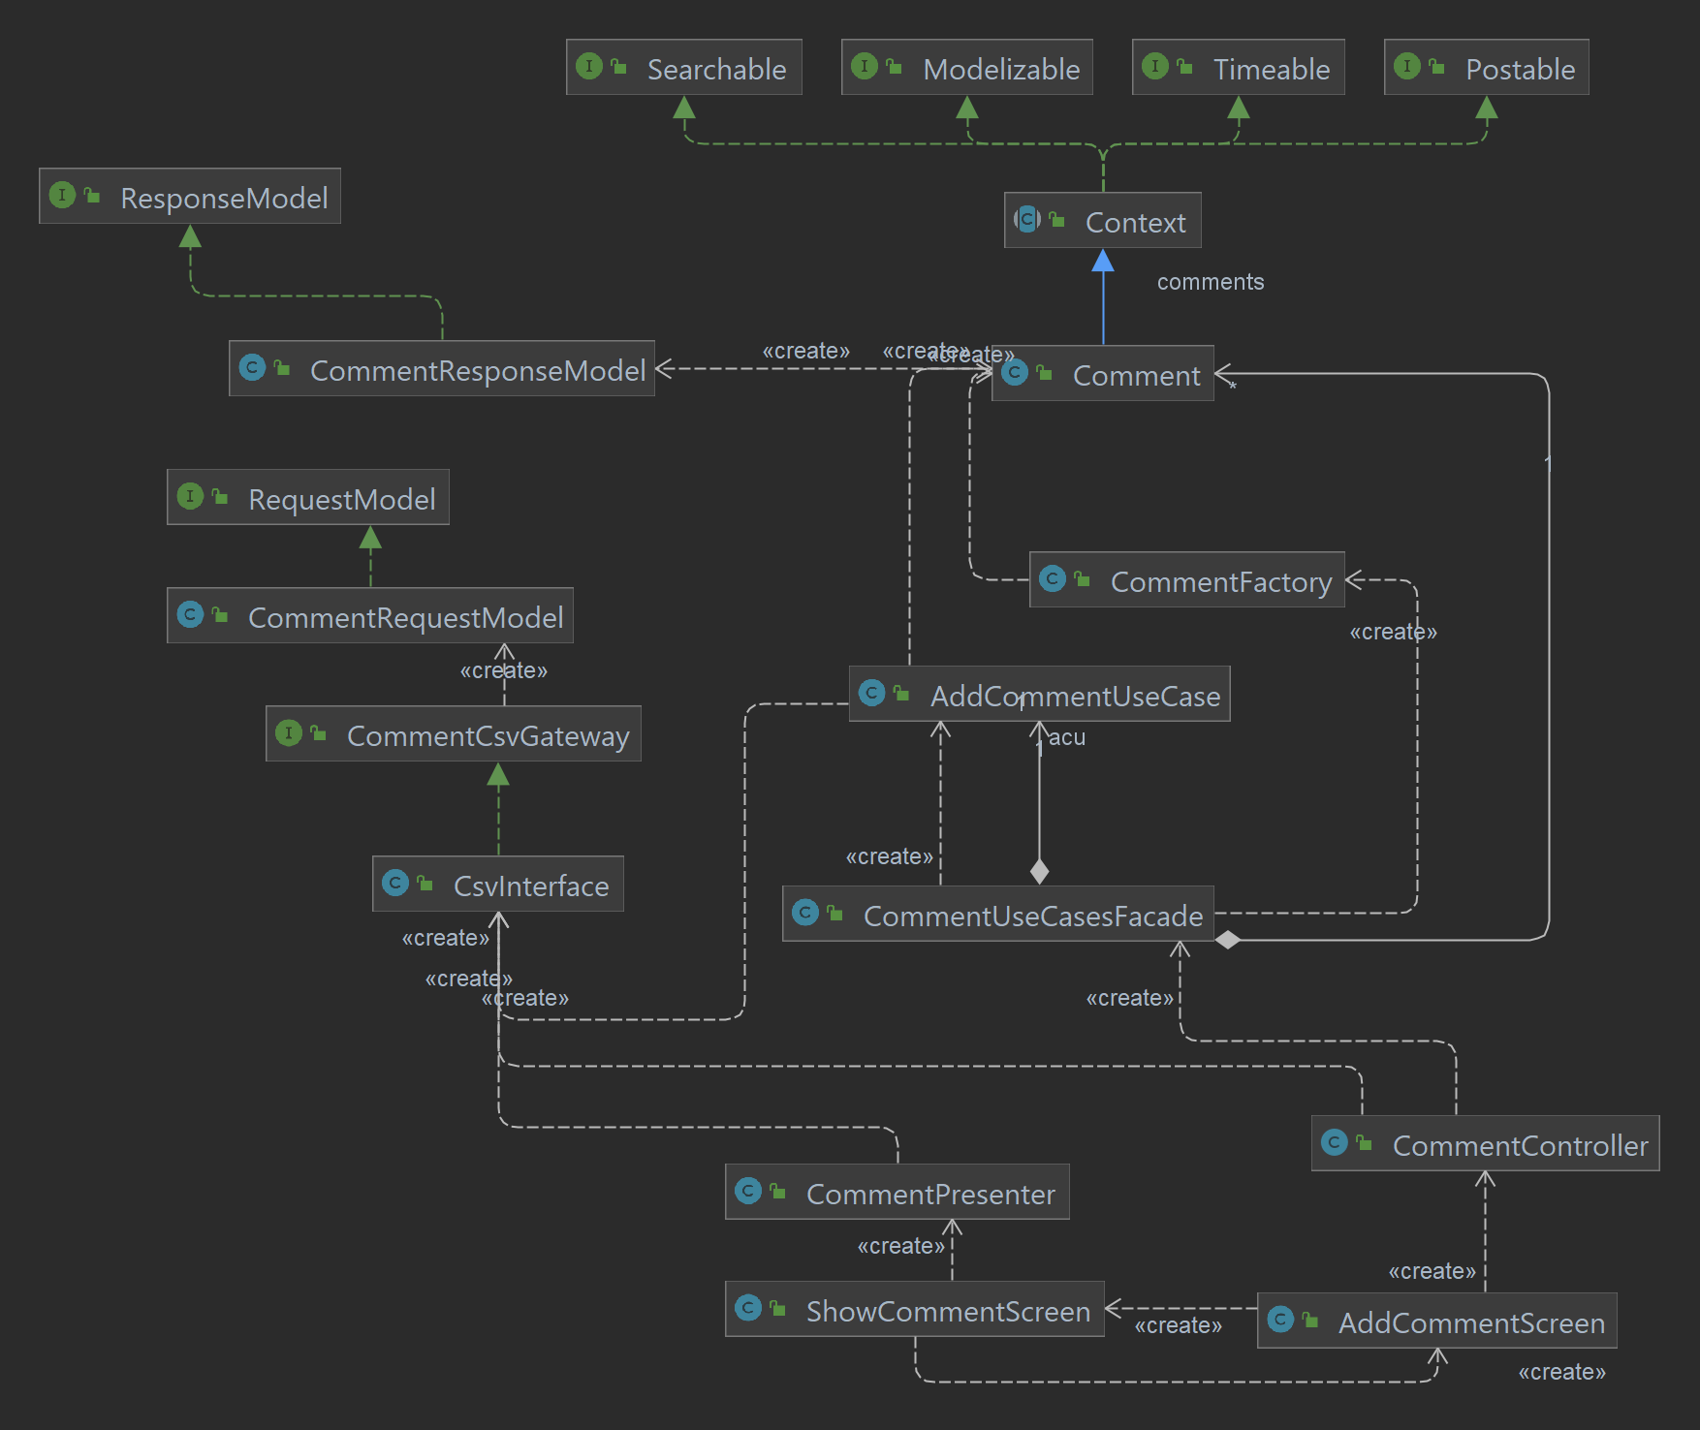
Comment Use cases
Notes:
I implemented the feature of adding a comment to a certain post and displaying the comments for a post.
Clean Architecture
My program fits the clean architecture because I have four layers.
Frameworks & Drivers layer contains database and UI.
The Interface Adapters layer contains the controllers, the presenter and the gateways.
The Application Business Rules layer contains the use cases.
The Enterprise Business Rule layer contains the entities and factories.
The user adds comment in AddCommentScreen, the UI creates CommentController which then creates CommentUseCases. CommentController interacts with the database through csvInterface which returns CommentRequestModel. CommentController passes CommentRequestModel to CommentUseCases for it to add a comment.
CommentUseCases creates CommentFactory to create Comment entities. To interact with the database, CommentUseCases creates csvInterface which returns a data class CommentResponseModel so then CommentUseCases can pass CommentResponseModel to CommentController. Then CommentController adds the comment to the database.
To show a list of comments and its users, ShowCommentScreen creates CommentPresenter which returns a list of comments + users in string format. So ShowCommentScreen can display the list. CommentPresenter interacts with the database through csvInterface which returns CommentRequestModel for CommentPresenter to transfer these models to a list of strings.
Difficulty
There was no CommentRequestModel and CommentResponseModel, so CommentController and CommentPresenter depend on Comment entities directly. There is dependency between the third layer: controller and the first layer: entity which is prohibited. Now we added CommentRequestModel and CommentResponseModel.
Design patterns
Simple factory - CommentFactory takes in CommentRequestModel and produce Comment entities
Facade - implemented CommentUseCases by separating functions into different classes and then integrating them in the CommentUseCasesFacade.
Dependency injection - CommentUseCases has dependency on Comments. Such dependency is enabled by passing a list of entities directly to the use case class’s constructor
Template method - CommentResponseModel inherits ResponseModel and CommentRequestModel inherits RequestModel The subclasses override get() method in the parent class to produce models more specific to Comment entity.
Proxy - CommentResponseModel and CommentRequestModel act as placeholders for the entities and prevents immediate access to Comments.
SOLID Principle

Slide 6
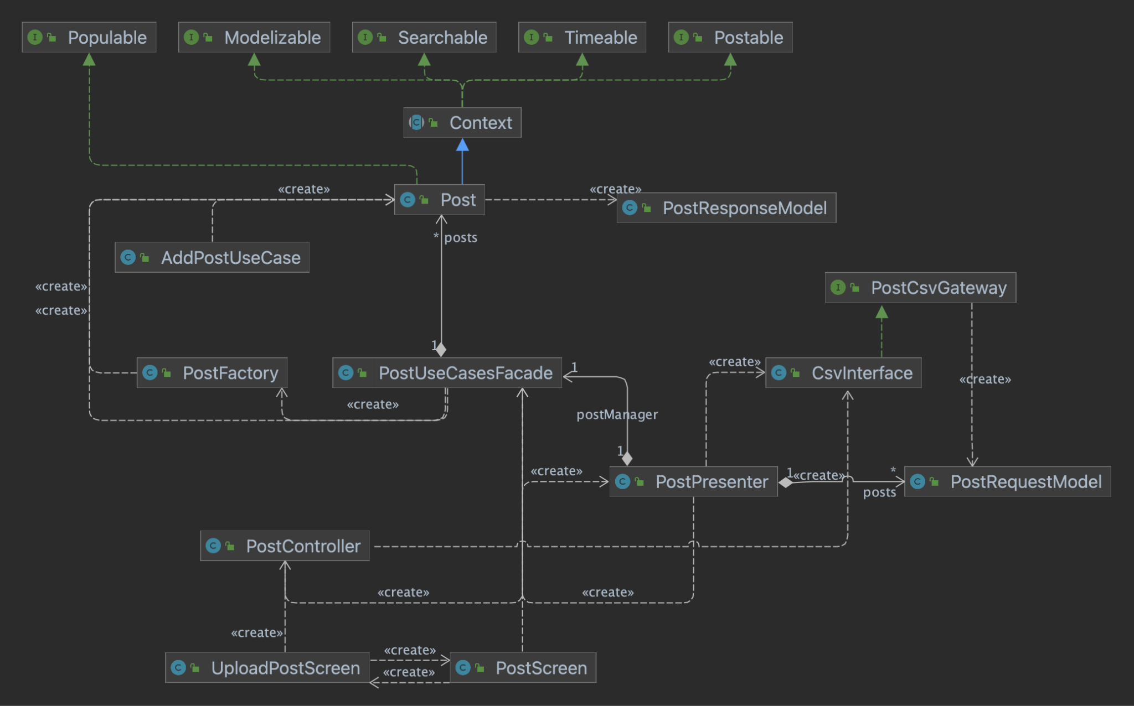
Post Use Cases
Notes:
Me and my other teammates implemented the post use cases, which is for posting a post with title, topics and contents, viewing posts and liking posts.
There are more use cases and sub-post screens we implemented, for a cleaner view, only one of those are listed in the diagram.
For example, uploading the post:
The user will input all required informations at the textboxes on the UploadPostScreen, where the input will be passed to PostController. Then the controller will interact with the csv files through PostCsvGateway and csvinterface, returning a PostRequestModel. The controller will take the PostRequestModel to PostUseCases in order to add a new post.
Then PostUseCases creates PostFactory which creates a Post entities. Furthermore, PostUseCases creates csvInterface which returns a PostResponseModel so then PostUseCases can pass PostResponseModel to the Controller. Then PostController adds the post with its information to the database.
Clean Architecture:
The post use cases adheres Clean Architecture since there are four layers
Frameworks & Drivers layer contains database and UI.
The Interface Adapters layer contains the controllers, the presenter and the gateways.
The Application Business Rules layer contains the use cases.
The Enterprise Business Rule layer contains the entities and factories.
Design pattern
Simple factory - PostFactory takes PostRequestModel and produce Post entities
Facade - implemented PostUseCases by separating each functions into individual classes and then integrating them in the PostUseCasesFacade.
Dependency injection - PostUseCases has dependency on Post. Such dependency is enabled by passing a list of entities directly to the use case class’s constructor
Template method - PostResponseModel and PostRequestModel inherits ResponseModel and RequestModel respectively. The subclasses override the getter in the parent class to produce models more specific to Post entity.
Proxy - The request and response model serve as placeholders for the entities and prevents access to Post entities right away.
Difficulties:
In the beginning, i encountered a small problem is that i need a csv reader and a csv writer in order to record and extract post information from the csv file, that is where we store our data. Because i have getter and setter methods.

Slide 7
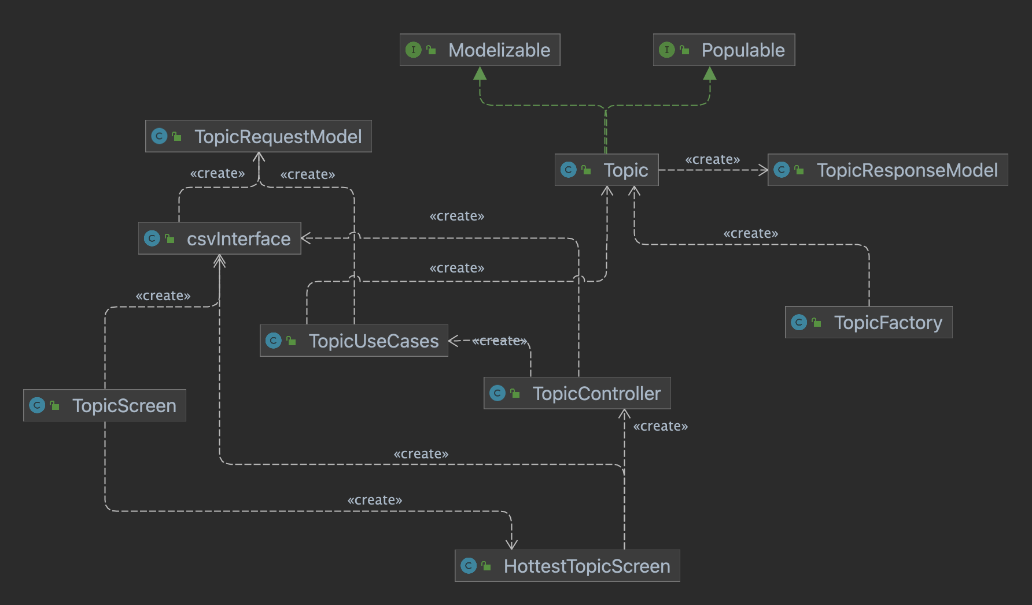
Topic Use Cases
Notes:
I implemented the feature of viewing the current topic and the hottest topics among all the topics we have.
When the user creates a post, the topic is decided based on the post content or topic input by the user. The users can view topics and hottest topics in the TopicScreen and HottestTopicScreen, the UI creates TopicController which then creates TopicUseCases. TopicController interacts with the database through csvInterface which returns TopicRequestModel. TopicController passes TopicRequestModel to TopicUseCases to get the hottest topics so far.
To show a list of topics, TopicScreen interacts with the database through csvIterface which returns TopicRequestModel, then transfer these models to a list of strings to display the topics so far.
Clean Architecture
My program fits the clean architecture because I have four layers.
Frameworks & Drivers layer contains database and UI.
The Interface Adapters layer contains the controllers, the presenter and the gateways.
The Application Business Rules layer contains the use cases.
The Enterprise Business Rule layer contains the entities and factories.
Difficulty
There was no TopicRequestModel and TopicResponseModel, so TopicController depends on Topic entities directly. There is dependency between the third layer: controller and the first layer: entity which is prohibited. Now we added TopicRequestModel and TopicResponseModel.
Design patterns
Simple factory - TopicFactory takes in TopicRequestModel and produce Topic entities
Facade - implemented TopicUseCases by separating functions into different classes and then integrating them in the TopicUseCasesFacade.
Dependency injection - TopicUseCases has dependency on Topic. Such dependency is enabled by passing a list of entities directly to the use case class’s constructor
Template method - TopicResponseModel inherits ResponseModel and TopicRequestModel inherits RequestModel The subclasses override get() method in the parent class to produce models more specific to Topic entity.
Proxy - TopicResponseModel and TopicRequestModel act as placeholders for the entities and prevents immediate access to Topics.
SOLID Principle

Slide 8
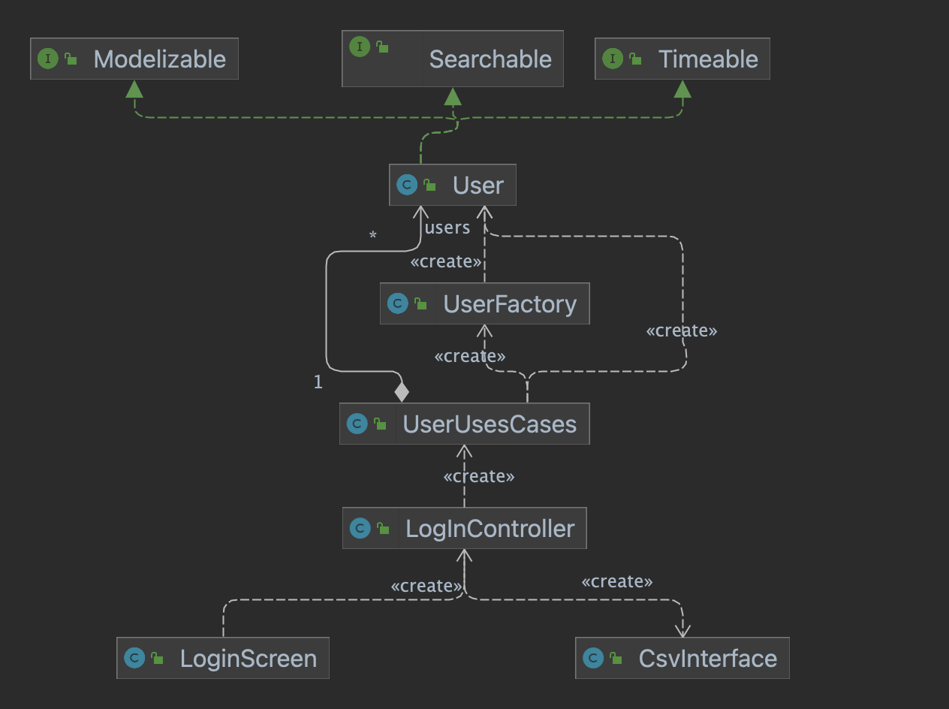
User Use Cases
Notes:
Frameworks & Drivers layer contains database and UI.
The Interface Adapters layer contains the controllers, the presenter and the gateways.
The Application Business Rules layer contains the use cases.
The Enterprise Business Rule layer contains the entities and factories.
Difficulties: Before I finds it hard to use the layout feature of the program and also struggle to incorporate the crc architecture to our project. However, after consulting the TAs with my problems with the solid principle and the architecture, I am able to set up the layers and the models for the user use cases.
I first attach the user to the three boundaries we have for the entities and then I created the responsemodel and request model of the user entity for the input and output boundary. My design for the use case follow the similar design of using simple factory to create the user, and use proxy to encrypt user from different layers.

Slide 9
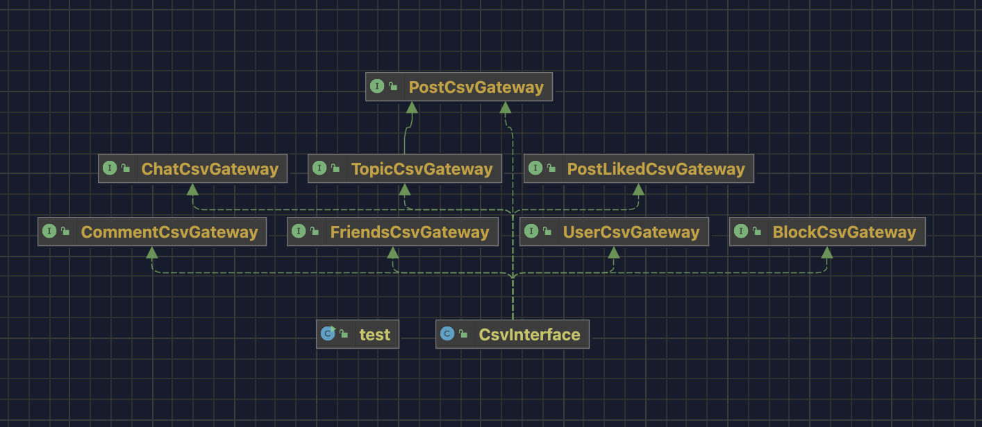
Database Interface
Notes:
I implemented the Database Interface, so everyone can save their data in the corresponding csv files.
Difficulties: One difficulty I faced when designing the csvInterface is, I always need to change my code around in according to my teammates’ needs. Thus I had plenty problems trying to keep up with all the changes. That’s why I started using the strategy design pattern. And it solved my problems.
Design Pattern: I used the Strategy design pattern, where I have the csvinterface only contains the Interfaces of the classes I need to use. This way, my implementation of the class csvInterface can be independent of a particular implementation of an algorithm, like how I implemented the classes to read and write users.
I also created a lot of test suites to thoroughly test all the input and output of the csvinterfaces, like the read and write of the topiccsvgateaway, the read and write of the commentcsvgateway… etc. I covered all the gateways as shown in the picture.

Slide 10
User
Interface

Slide 11
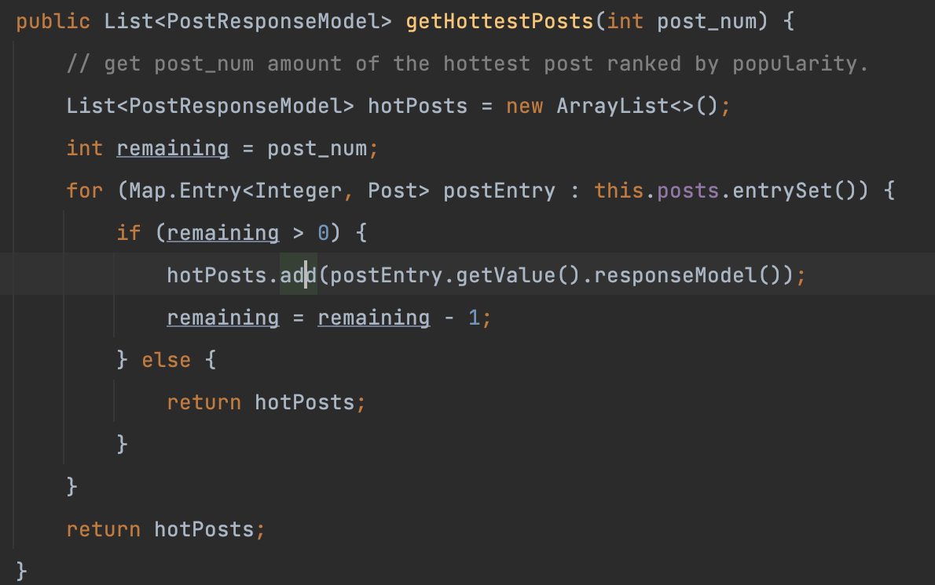
Not so Popular… But Early Enough

Slide 12
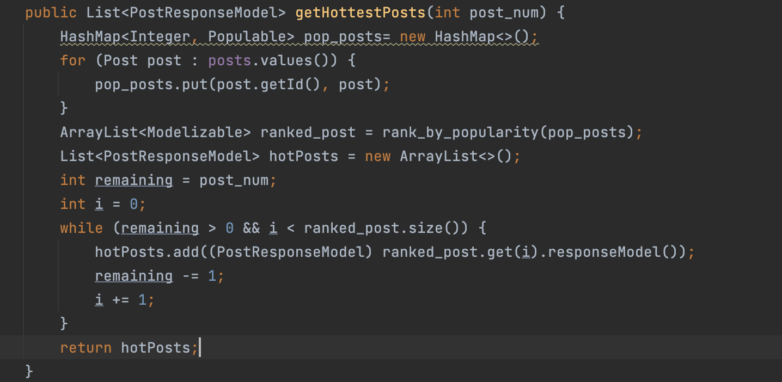

Slide 13
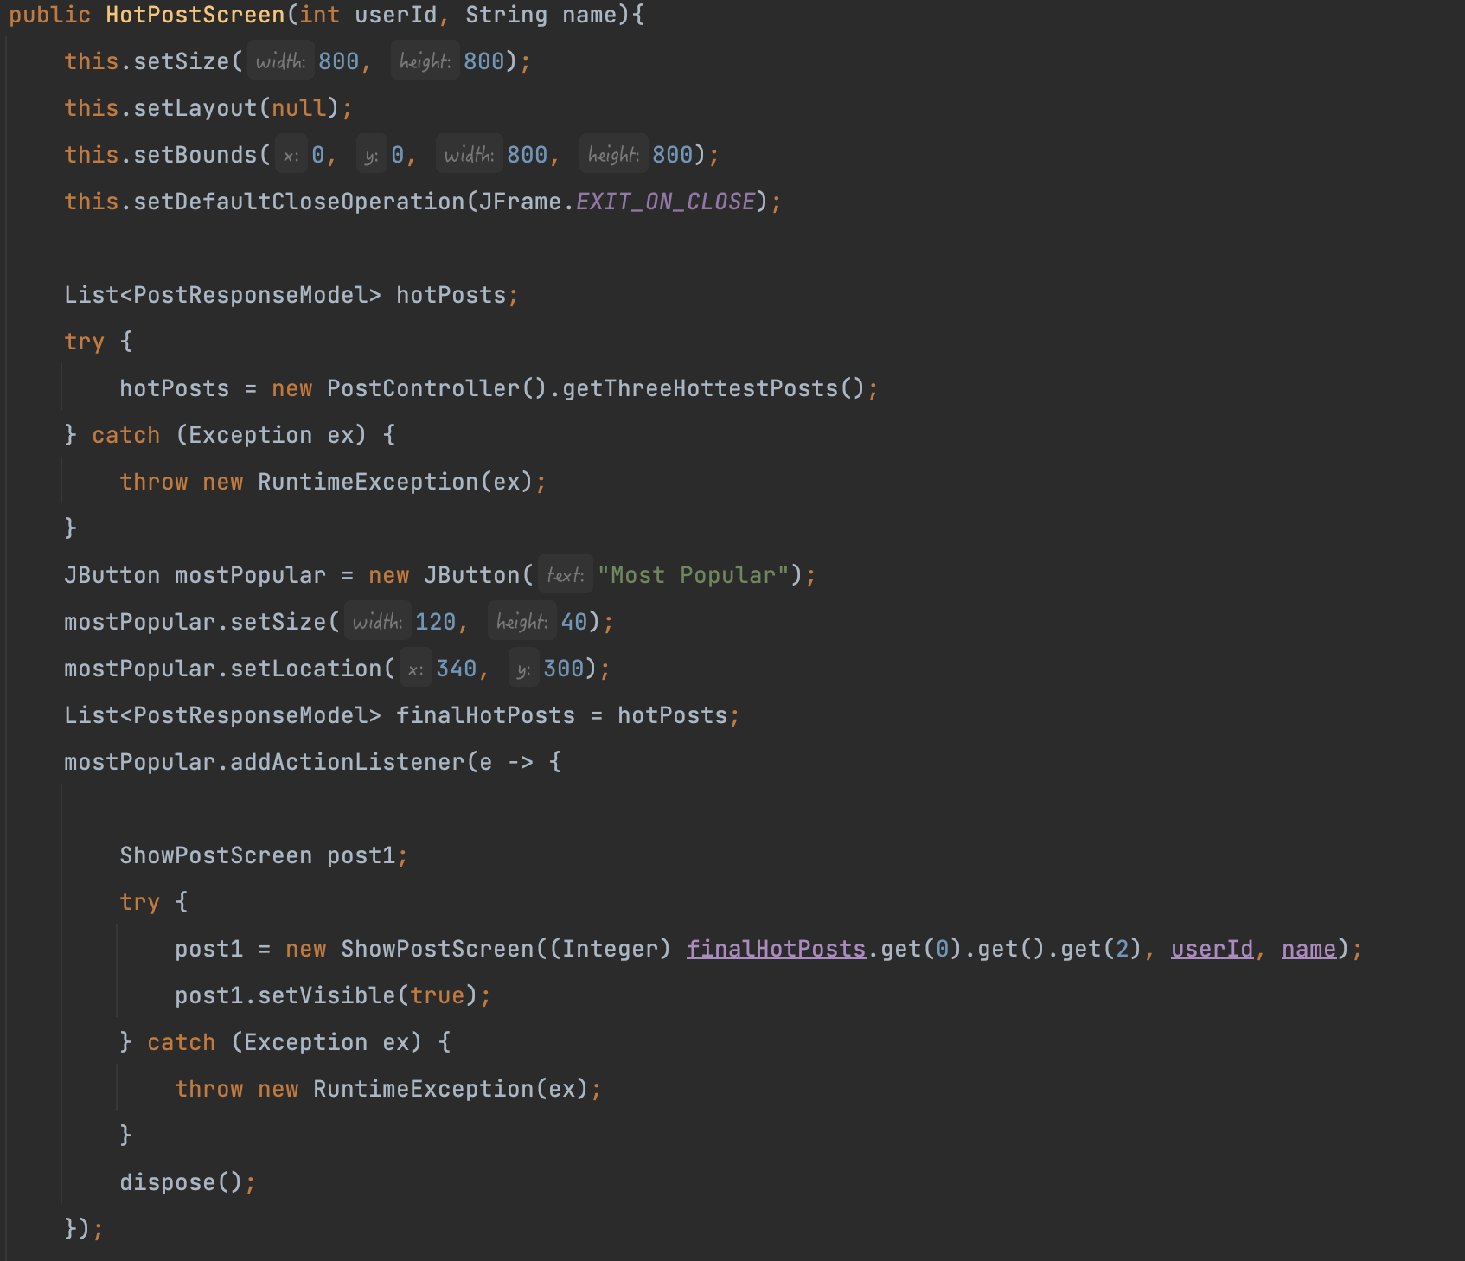

Slide 14

Notes:
这是我故意放在这里的，不要删 —— lty

Slide 15
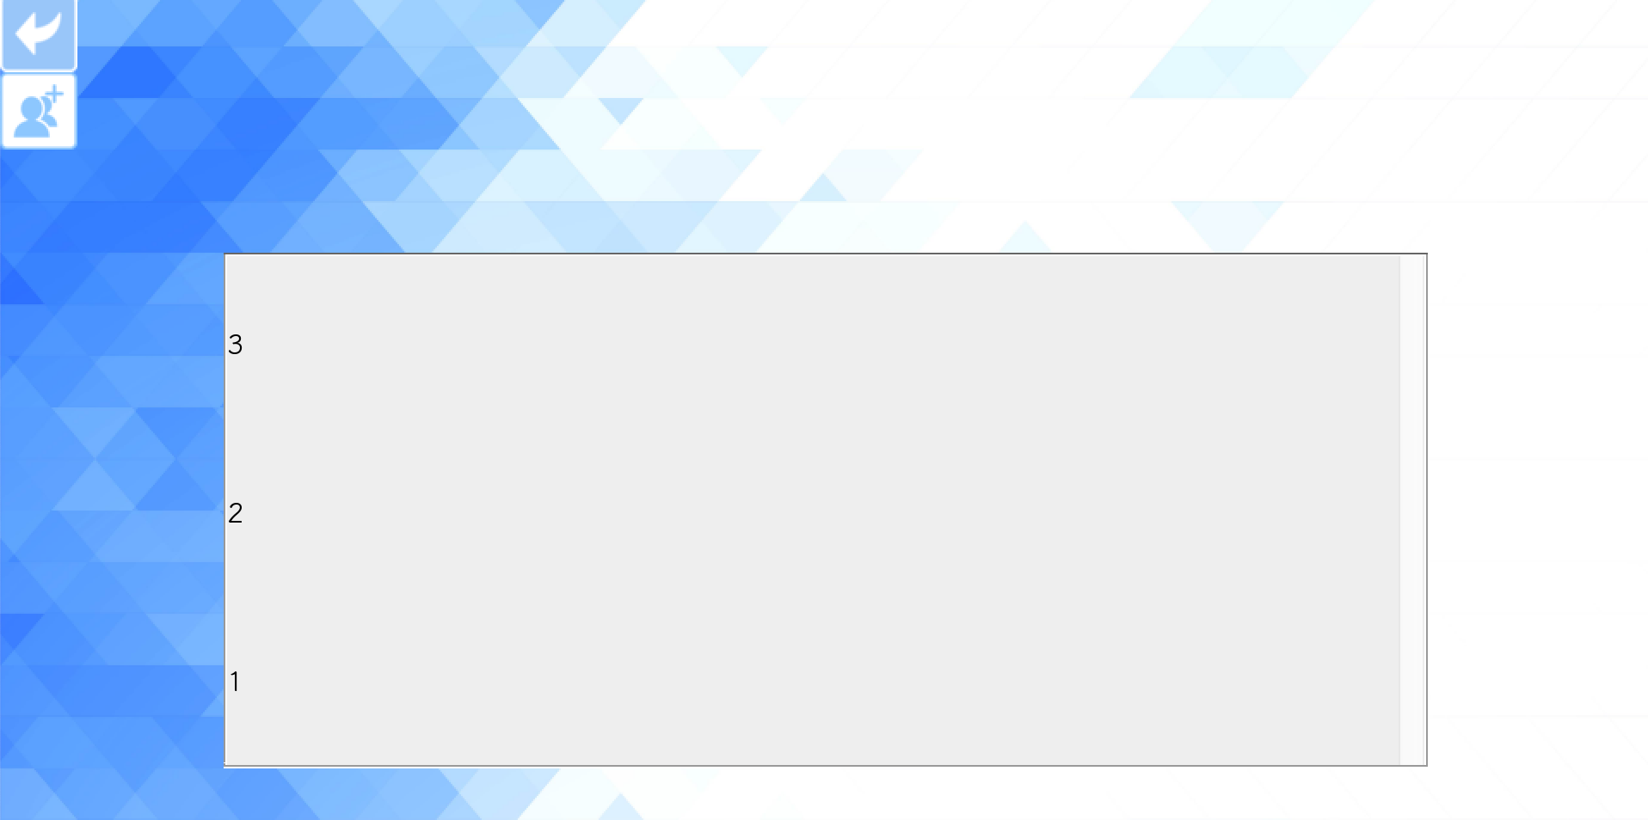
Issues With Friends and Chat

Slide 16
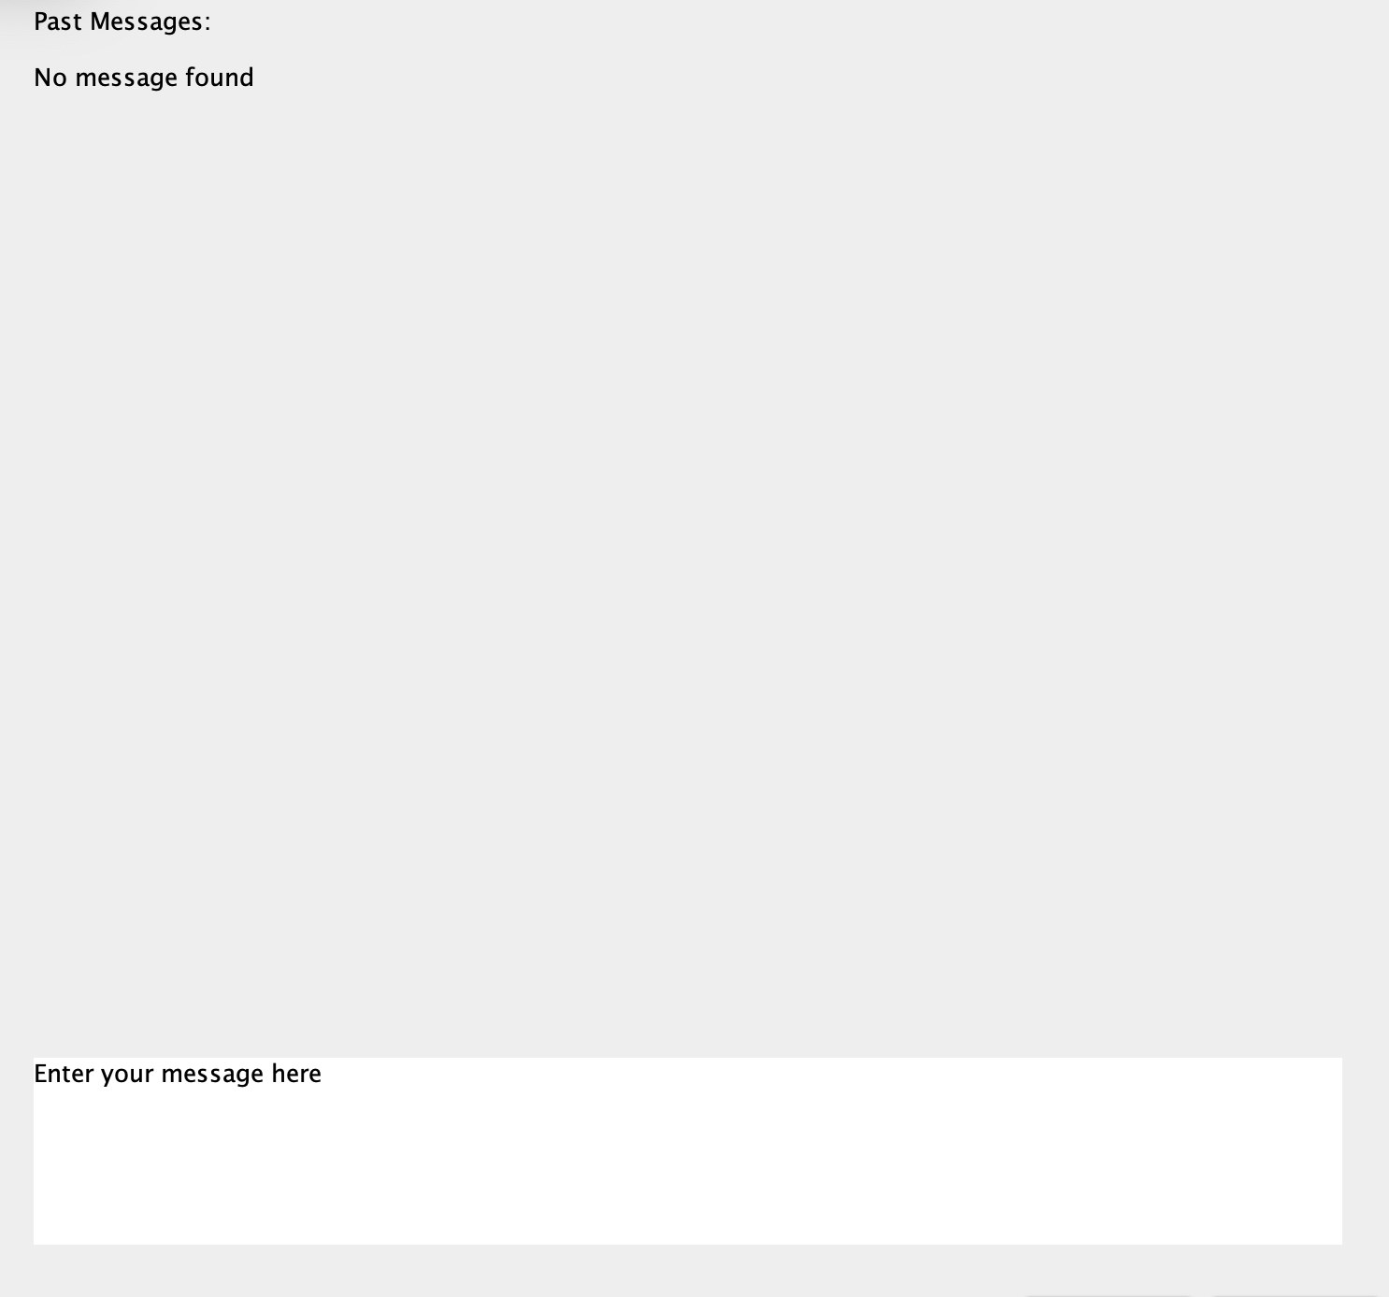
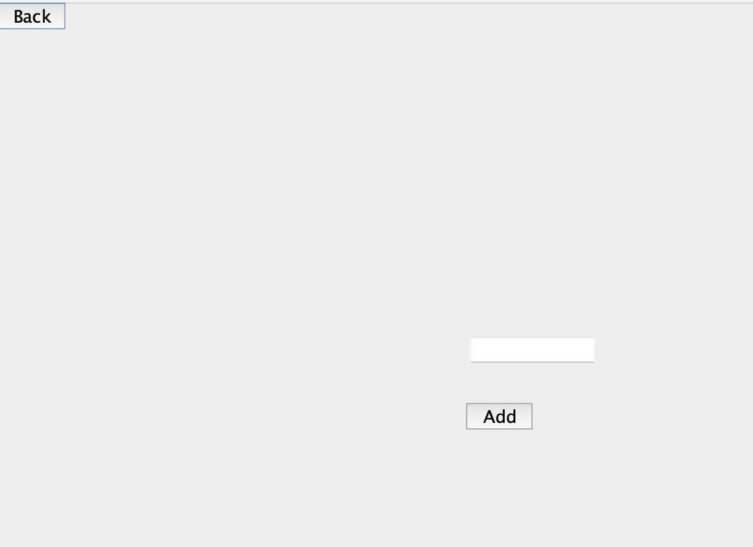

Slide 17

Main Screen Design

Slide 18











Logos and Icons

Slide 19
Design
Patterns

Slide 20
Design Patterns
Simple Factory
Facade
Dependency Injection
Command
Template Method
Proxy

Slide 21
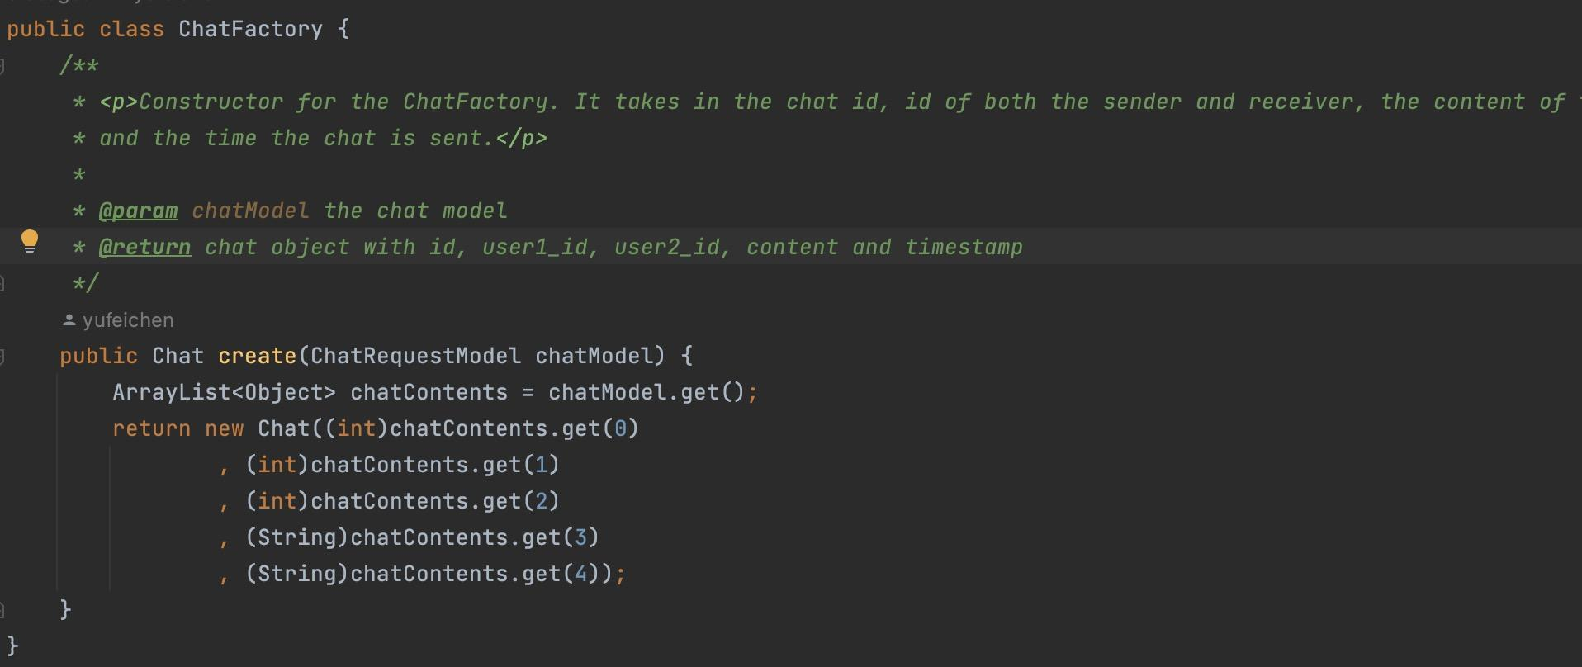
Simple Factory
Notes:
Simple factory: The program has a class that has one creation method with a large conditional that based on method parameters chooses which product class to instantiate and then return. Here, we have a chat factory that has a create method, which takes in a chat request model and create a chat entity.

Slide 22
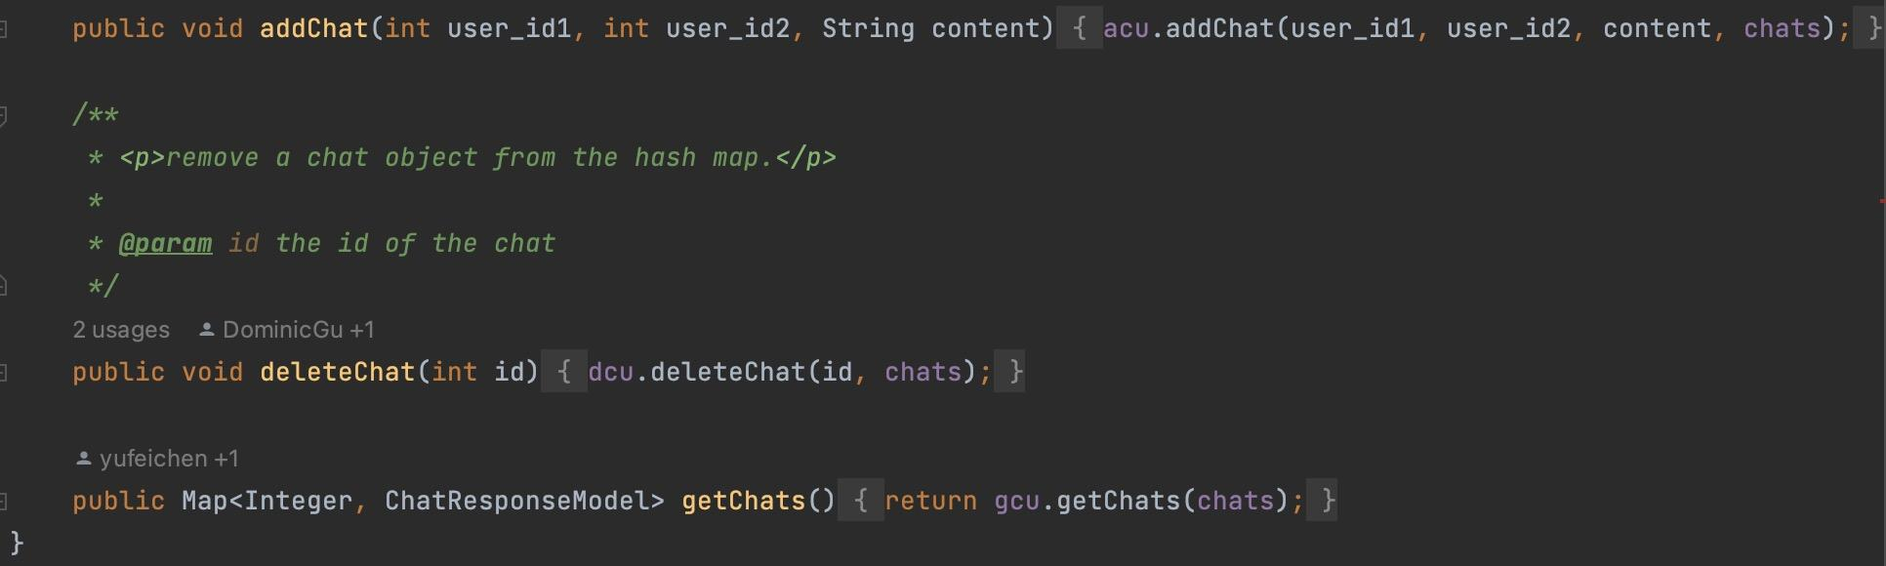
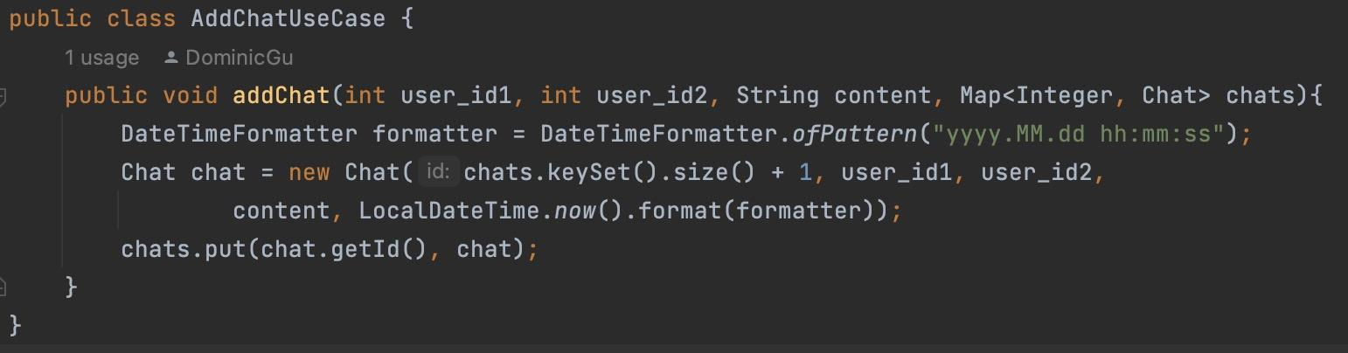
Facade
Notes:
Facade: The program has a class that has a single method that hides the complexity of a system and provides a simple interface to the client. Here, we implemented use cases by separating different functions into different classes and then integrating them in the use case facade.

Slide 23
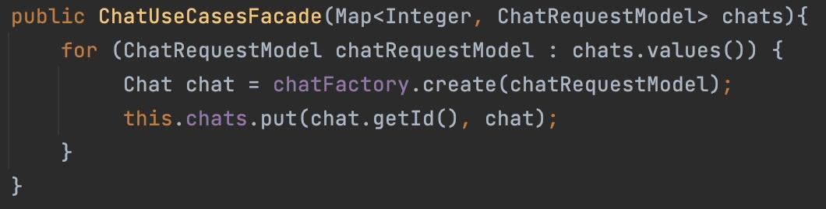
Dependency Injection
Notes:
Dependency injection: The program has a class that has a dependency on another class and the dependency is passed in through the constructor. Here, the chat use case has dependency on its corresponding entity. Such dependency is enabled by passing the entity directly to the use case’s constructor

Slide 24
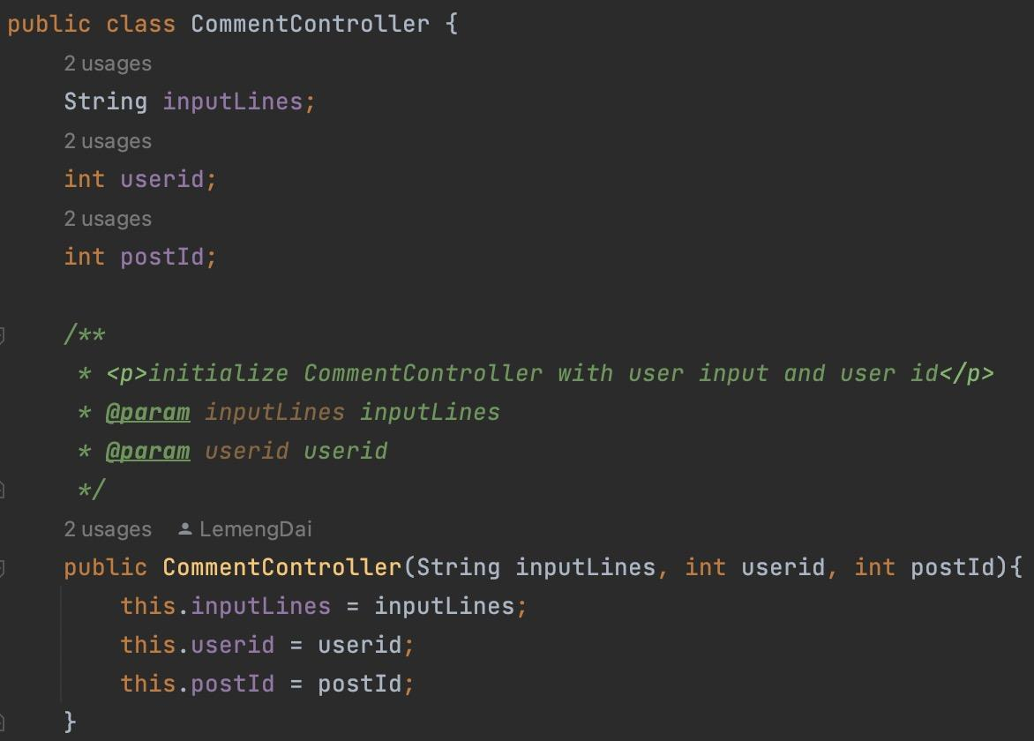
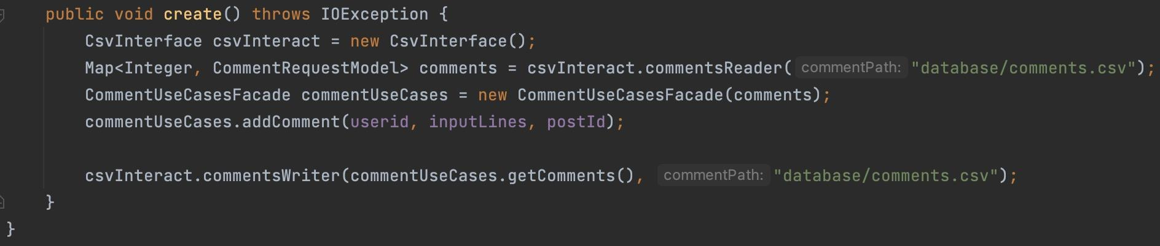
Command
Notes:
Command: The program has a class that has a method that takes in user inputs as the requested values. Here, the chat controller of the program will change the request into chat model and pass it to the use cases to operate.

Slide 25
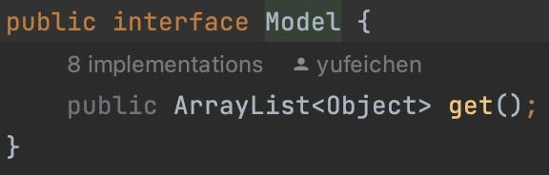
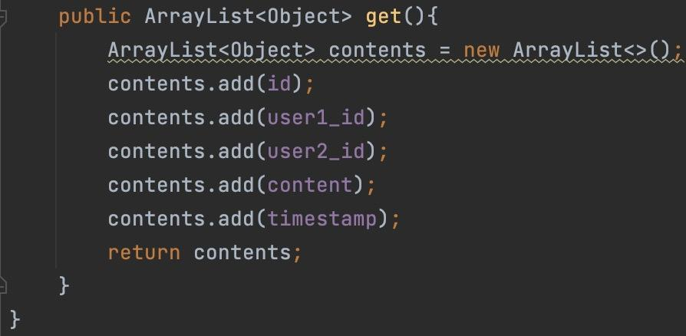
Template Method
Notes:
Template method: The program has a class that has a method that defines the skeleton of an algorithm and defers some steps to subclasses. We have output boundary ResponseModel and input boundary RequestModel which are inherited by multiple response models and request models. The subclasses override get() method in the parent class.

Slide 26
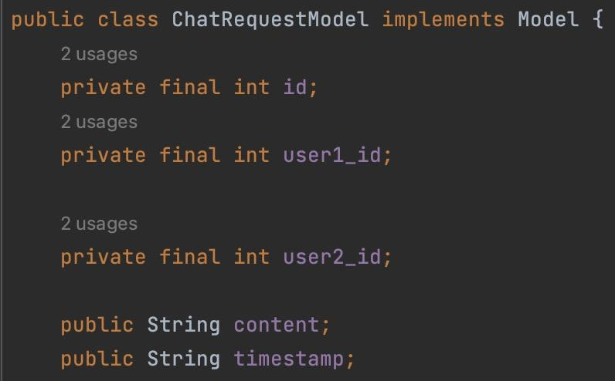
Proxy
Notes:
Proxy: The program has a class that has a method that acts as an interface to something else. The program has response and request models for chat entity. The models act as placeholders for the entities and prevents immediate access to these entities.

Slide 27
Clean
Architecture

Slide 28
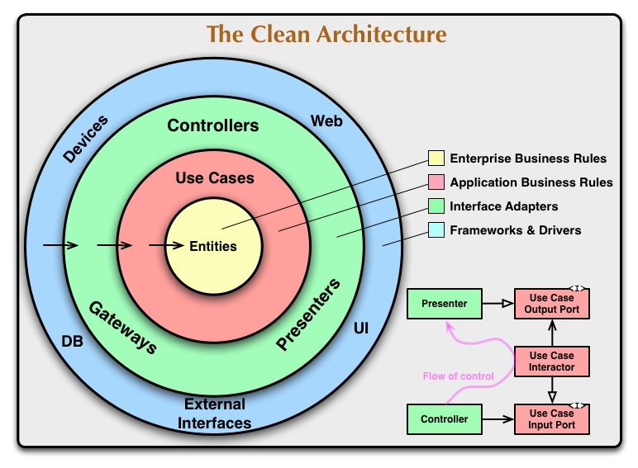
The program is divided into 4 layers: Frameworks & Drivers, Interface Adapters, Application Business Rules, Enterprise Business Rule
Frameworks & Drivers layer: database and UI
Interface Adapters layer: controllers, presenter and gateways
Application Business Rules layer: use cases
Enterprise Business Rule layer: entities and factories

Slide 29
Future
Implementation

Slide 30
Future design plans
1, Implementing remote database
E.g. remote sql database with remote sql database interface
3, More design patterns
E.g object pool
observer
2, Include more use cases
E.g. friend recommendation
Topic analyzing
Notes:
Our project currently uses local database as source of storing. In our future design, we hope to change the local csv interface to remote sql database interface so that people can use our project with online access
When we have more time, we hope to add more algorithms into our project, like the LTC model to predict the topic for a range of texts, or using the friends recommendation model to add recommend friends functions
We hope to add more design patterns to our project to increase the efficiency of the program. For example, the object pool can be used to our entities so that the unused post will not take up spaces. Also, observer can be used to help with our use cases for user uploading posts or deleting the posts.

Slide 31
Accessibility

Slide 32
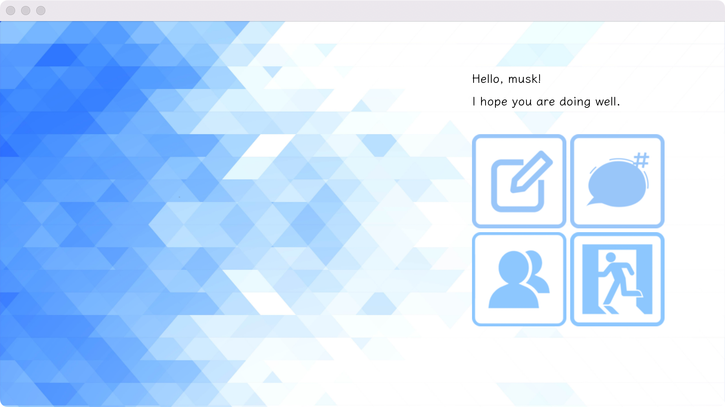
Most technology nowadays comes with accessibility features to read the screen’s content out loud for the users.
e.g. For MacOS: Settings -> Accessibility -> Spoken Content
With the functionality to read screen, our program is mostly accessible for individuals with visual impairment, except for the menu screen.
Ethics Principles
Notes:
Principle 1: Equitable Use
The design is useful and marketable to people with diverse abilities.
Principle 2: Flexibility in Use
The design accommodates a wide range of individual preferences and abilities.
Principle 3: Simple and Intuitive Use
Use of the design is easy to understand, regardless of the user's experience, knowledge, language skills, or current concentration level.
Principle 4: Perceptible Information
The design communicates necessary information effectively to the user, regardless of ambient conditions or the user's sensory abilities.
Principle 5: Tolerance for Error
The design minimizes hazards and the adverse consequences of accidental or unintended actions.
Principle 6: Low Physical Effort
The design can be used efficiently and comfortably and with a minimum of fatigue.
Principle 7: Size and Space for Approach and Use
Appropriate size and space is provided for approach, reach, manipulation, and use regardless of user's body size, posture, or mobility.

Slide 33
Thanks!

